Slide 1

Introduction to 3D imaging and Morphometrics
A. Murat Maga, PhD
Associate Professor
University of Washington
Division of Craniofacial Medicine
&
Seattle Children’s Research Institute
Center for Developmental Biology and Regenerative Medicine
SlicerMorph Core Team:
Co-PI: Adam Summers (UW FHL)
Co-PI: Doug Boyer (Duke Evol. Anthropology & Director of MorphoSource.org)
Consultant: Steve Pieper (Isomics Co., Chief Software Architect of 3D Slicer)
Lead Developer: Sara Rolfe (UW FHL & SCRI)

Slide 2
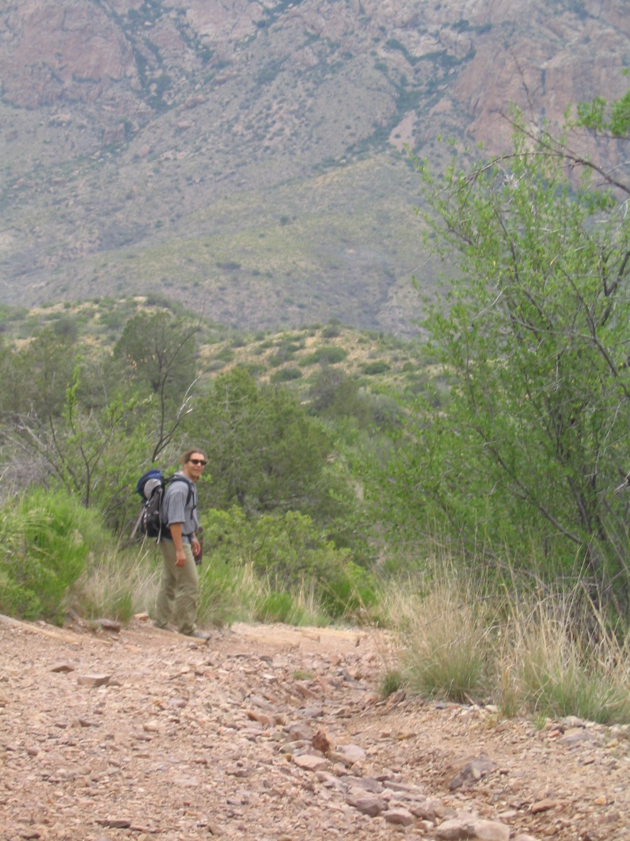
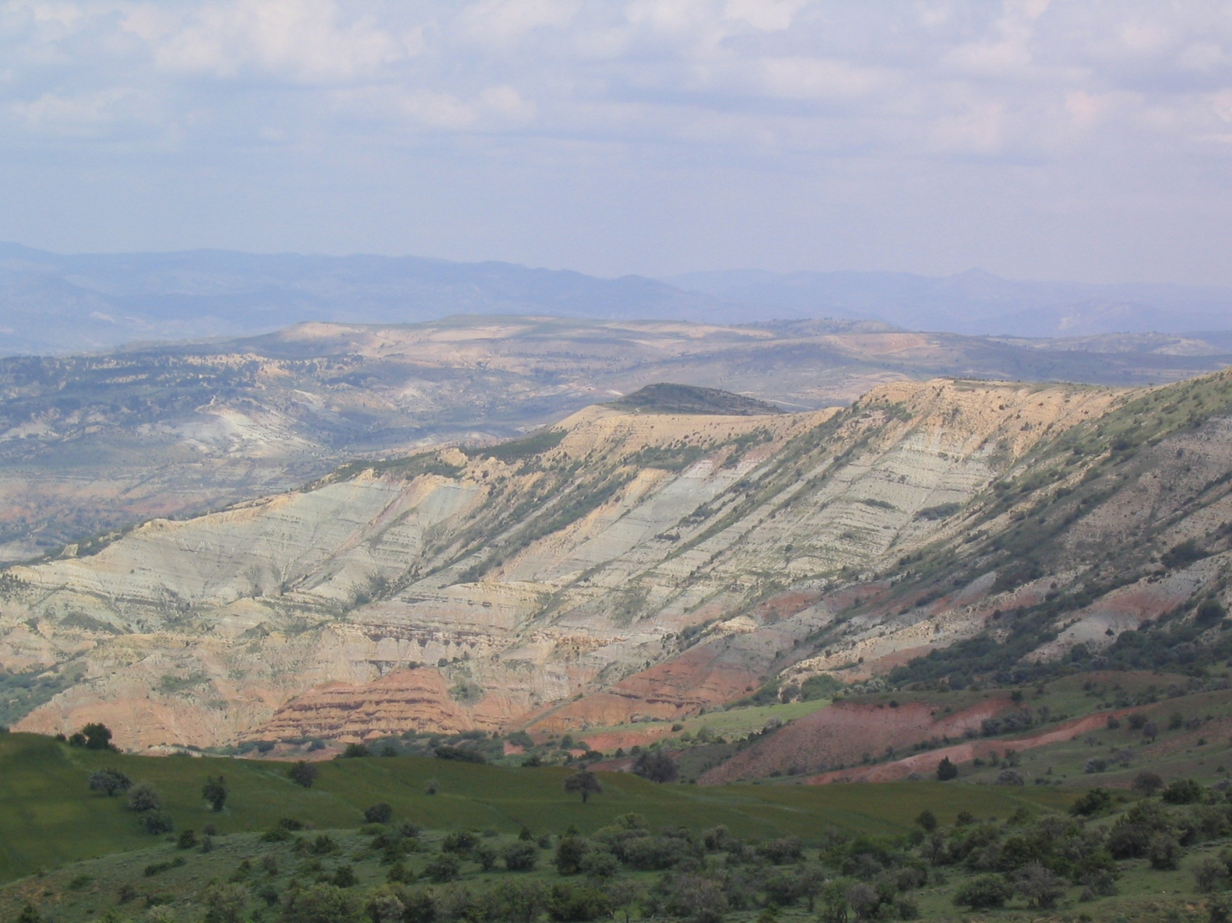
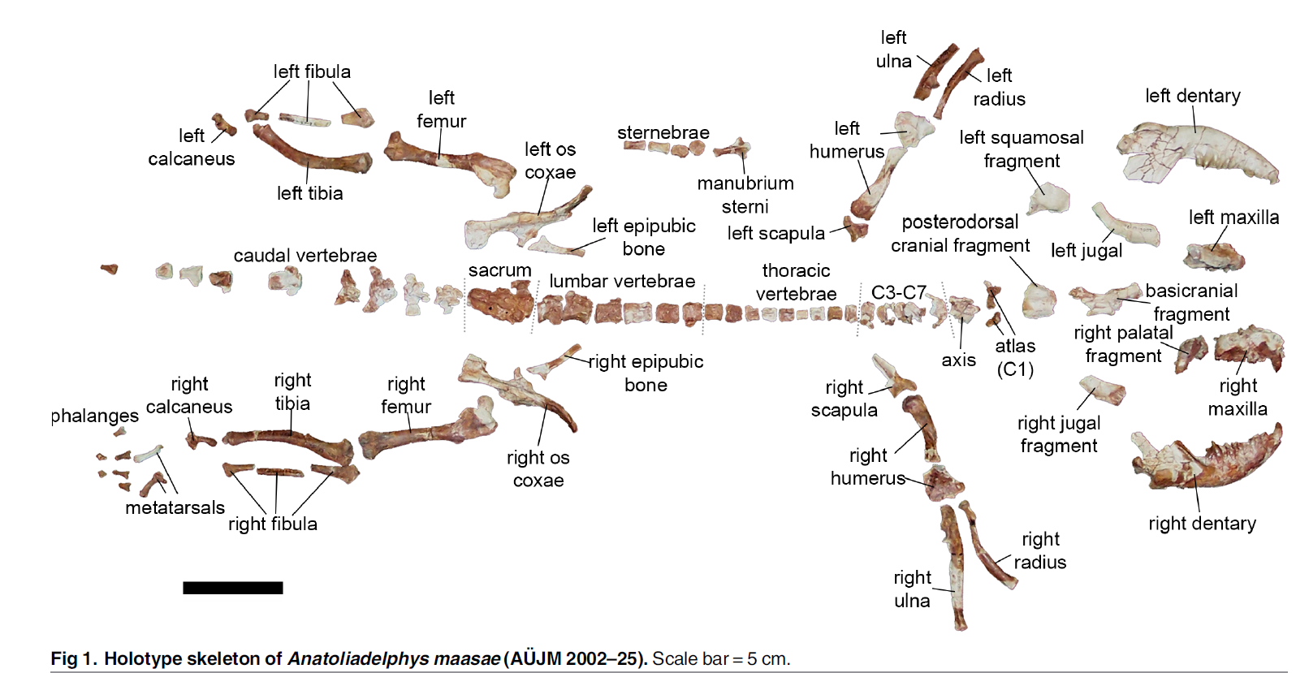
A marsupial in Turkey
Notes:
Then I was invited to join a fieldwork at a location from 15 minutes drive where my parents lived. The PIs on this project have been working on this site for 5 years. First day it was a bummer, as I lost my brand new rock hammer jumping up and down the boulders. But come next, day dump luck I found this:
Anybody would like to give a shot? Hint look at the two small bones that are dorsal to the pubes. Are they supposed to be there?
This turned out to be one of the most complete marsupial specimen that is known from that part of the world. So my dissertation has changed from humans to marsupials, which I never pretty much nothing. We don’t have them even in zoos in Turkey.

Slide 3
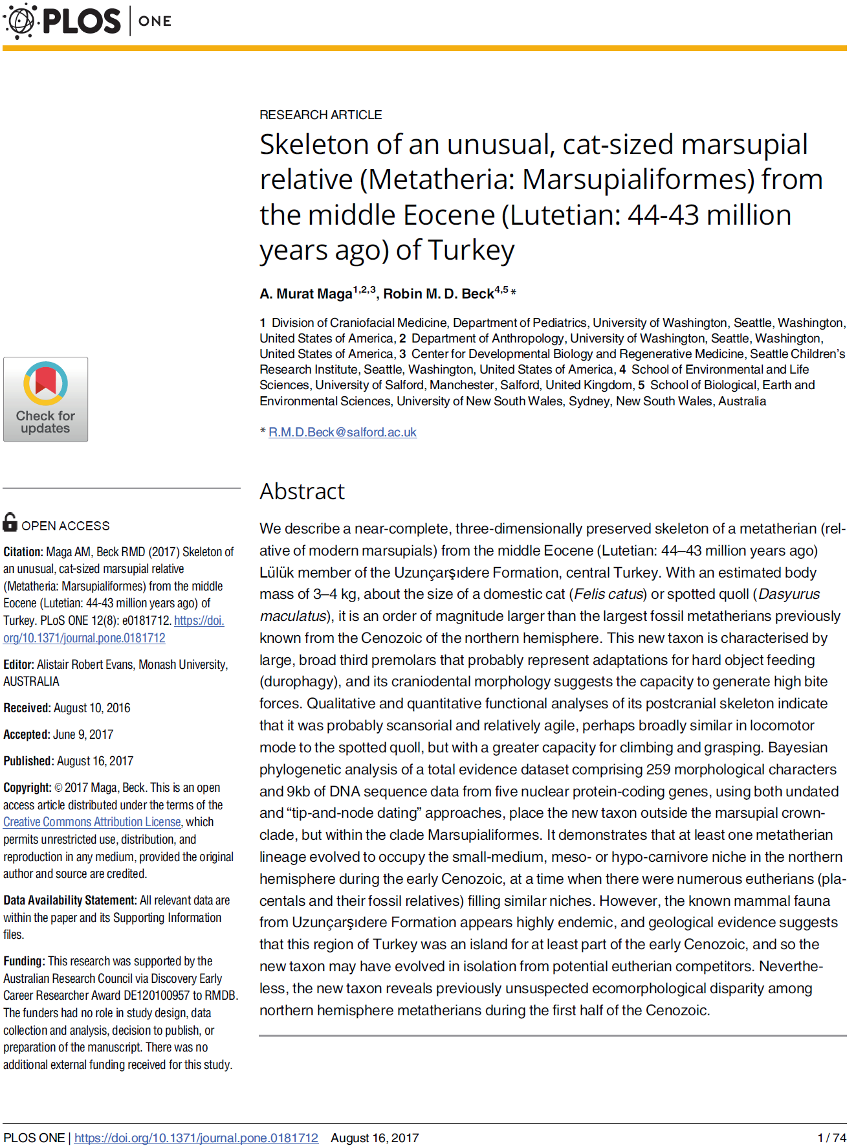
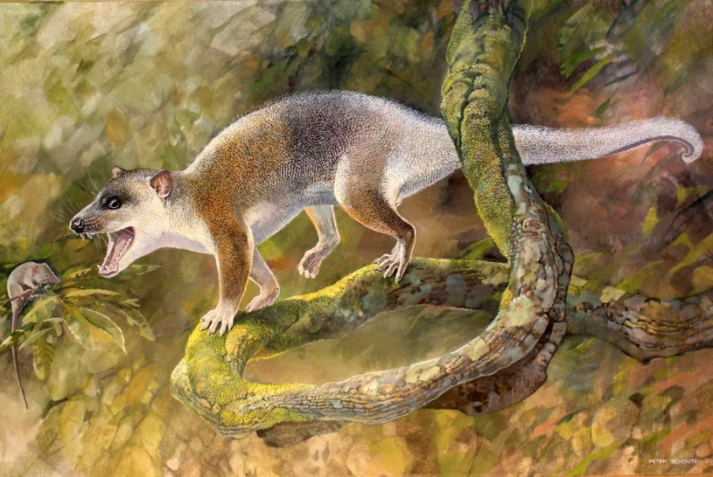
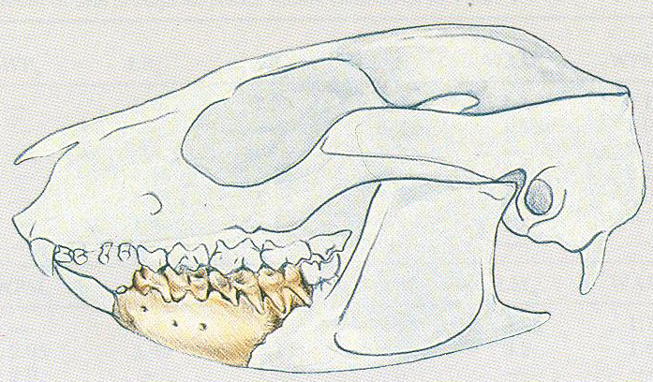
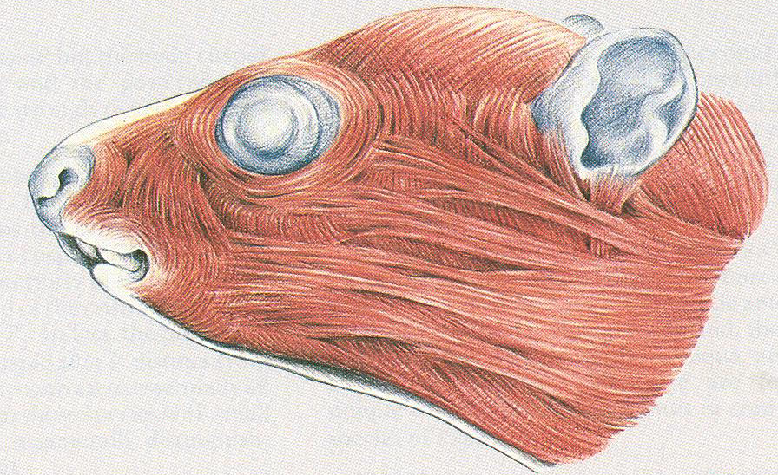
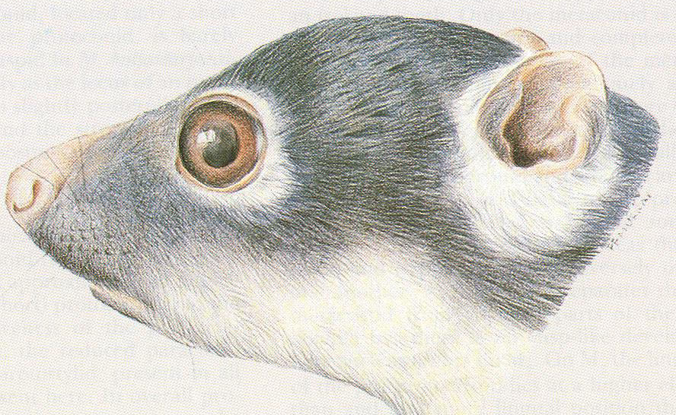
Anatoliadelphys maasae
Illustration by Coco Kishi
Illustration by Peter Schouten
Woodburne et al. 1987. New Miocene ringtail possums from South Australia

Slide 4
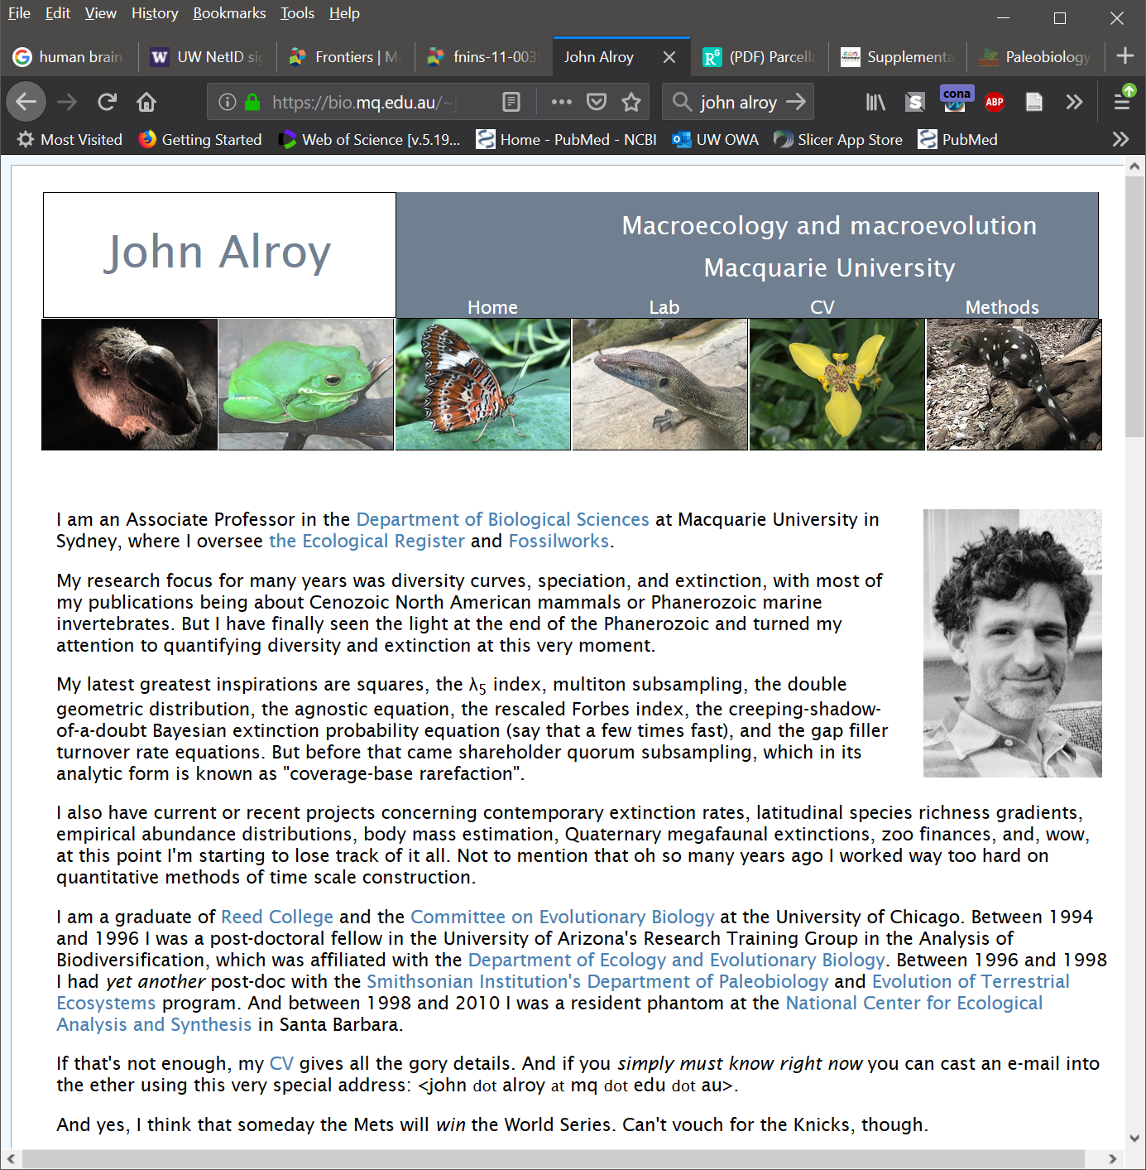
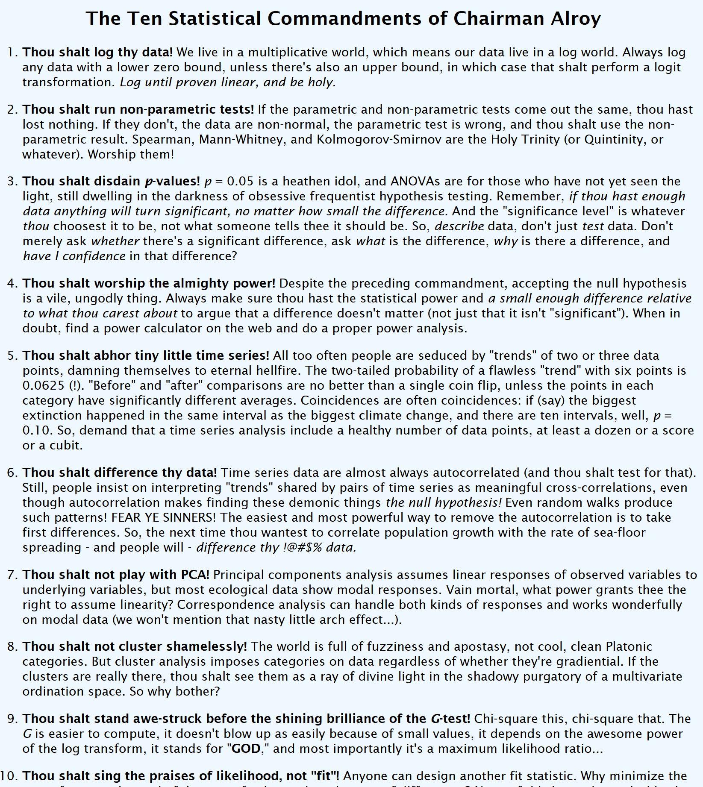
Workshops can be transformational!
https://www.nceas.ucsb.edu/~alroy/JA_commandments.html

Slide 5
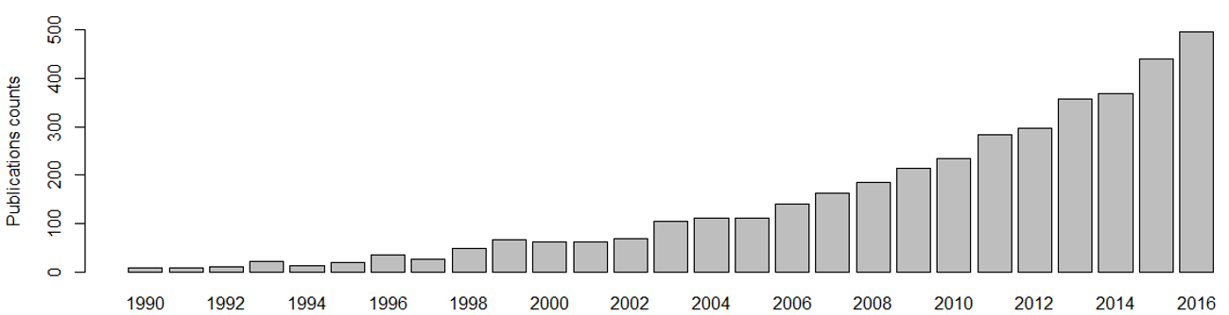
Quantitative Analysis of organismal form via geometric morphometrics is booming.
Data from Web of Science. Topic keywords: ‘geometric morphometrics’ OR procrustes

Slide 6
Morphometrics discussion list.
~1000 members from a global pool of scientists interested in using quantitative methods to analyze organismal shape and form.
Diverse body of interests: Ecologists, evo/devo biologists, systematists, paleontologists, anthropologists and biomedical researchers.
Motivating question: “I want to analyze shape covariation patterns in XYZ species... I found datasets in MorphoSource / DigiMorph etc….., but don’t know what to do”.

Slide 7
A typical workflow:
Download data from one or more of the repositories in different formats and/or modalities.
Find a software that will enable 3D visualization and/or digitization (commercial software like Aviso, Mimics, Geomagics, Analyze, or free ImageJ, 3D Slicer, ITK-Snap)
Export landmark data into a format that can be understood by the analysis software.
Analyze using R (or other specific morphometric software)
Export results back to the digitization software to visualize (may not be necessary for everyone).
Each of these steps can be error prone and frustrating. Our goal is to minimize these steps.

Slide 8
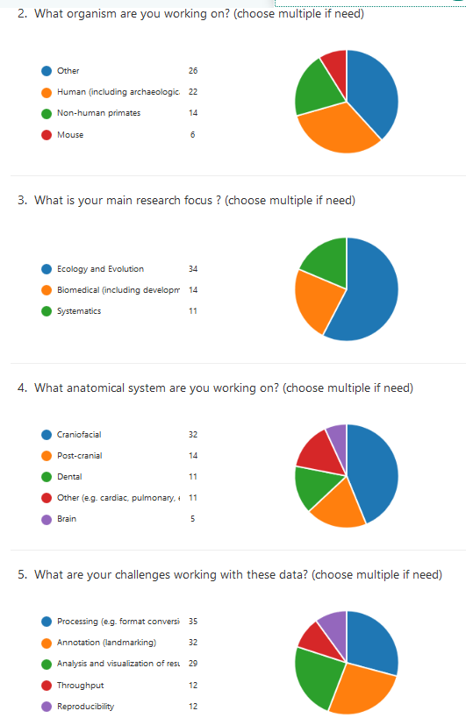
Survey of 3D morphometrics
I conducted a survey for people who are working (or planning to work) with volumetric datasets (CT, MR, and likes).
Challenges identified are:
Data wrangling (converting formats)
Annotation (landmarking, measurements)
Analysis and visualization

Slide 9
SlicerMorph Project Organization

Slide 10
Introduce the instructors.

Slide 11
Course logistics
Review schedule (flexibility
First time, feedback (both real-time and post-course evaluations) will be tremendously important. We are very broad in terms of coverage
Lightning talks this afternoon (box share to upload them PDFs are prefered).
Housing issues/campus map/meals etc
No debrief, but just hangout as a group to answer questions
Social event/Group photo
Make sure to signup for github for this afternoon’s lab.
Also sign up for SlicerMorph announcement email list (low traffic 5-10/yr) http://bit.ly/SM-listserv

Slide 12
Introduction to 3D imaging and Morphometrics
A. Murat Maga, PhD
Associate Professor
University of Washington
Division of Craniofacial Medicine
&
Seattle Children’s Research Institute
Center for Developmental Biology and Regenerative Medicine
SlicerMorph Core Team:
Co-PI: Adam Summers (UW FHL)
Co-PI: Doug Boyer (Duke Evol. Anthropology & Director of MorphoSource.org)
Consultant: Steve Pieper (Isomics Co., Chief Software Architect of 3D Slicer)
Lead Developer: Sara Rolfe (UW FHL & SCRI)

Slide 13
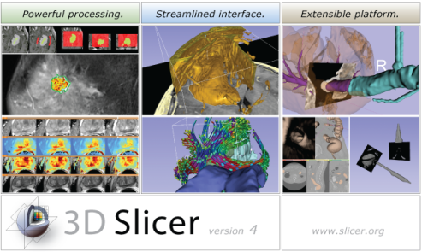



Background for 3D Slicer
Software application for medical image computing: data import/export, visualization, segmentation, registration, quantification, real-time guidance
Application framework: customizable, extensible custom modules
Completely free (BSD)
Multi-platform
User and developer support
Training courses, documentation, tutorials
Fedorov, et al. "3D Slicer as an image computing platform for the Quantitative Imaging Network." Magnetic resonance imaging 30.9 (2012): 1323-1341.
Notes:
Valley of death: Slicer does not fit traditional science funding mechanisms:
Science agencies: its not innovative
Companies: no proven clinical utility, too risky

Slide 14
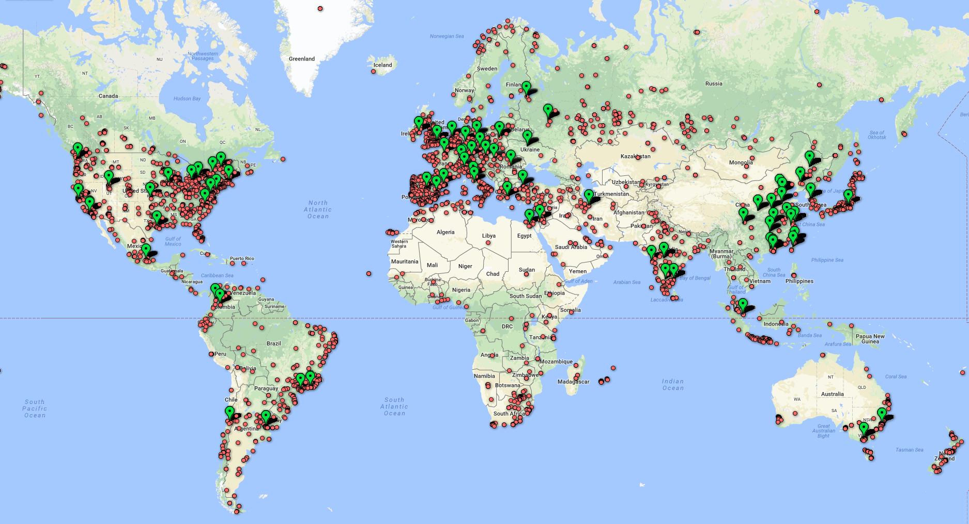
Large user community
500 downloads per week in 2012
2800 downloads per week in 2018
330 000+ downloads over the past 5 years:
Notes:
And as you can see, Slicer has a similarly sized user base here in Europe as in North-America.

Slide 15
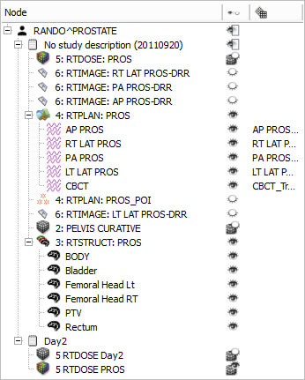
Data import/export
DICOM: 2D/3D/4D volumes, structure sets, dose volumes, etc. (extensible without Slicer core changes)
Research data formats for volumes, meshes, transforms (NRRD, MetaIO, VTK, HDF, etc.)
Common non-medical data formats (JPEG, TIFF, etc.)
Save and complete restore of application state
Notes:
Slicer supports many ways of importing and exporting data that one wants to visualize:
1. Through the DICOM (is a standard for handling, storing, printing, and transmitting information in medical imaging.) importer (which supports … )
2. Common research data formats
3. Basic data formats
Additionally, it is also possible to, at anytime, save the entire application state in order to restore the complete application state at a later time. (US ELEPHANT DEMO?)

Slide 16
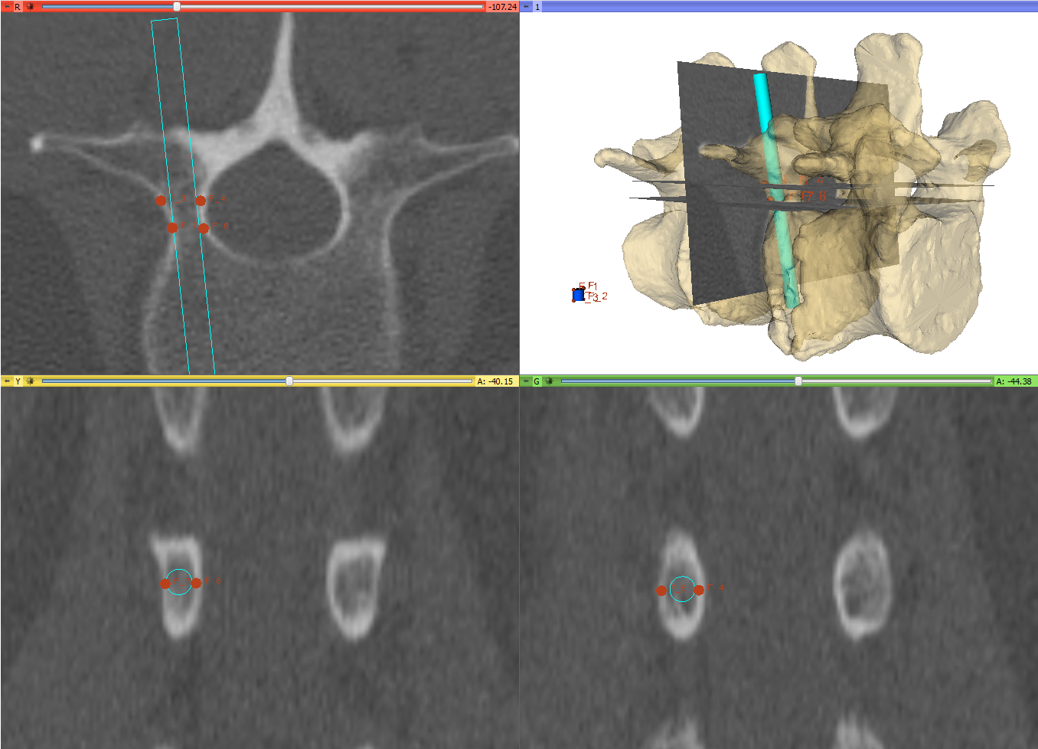
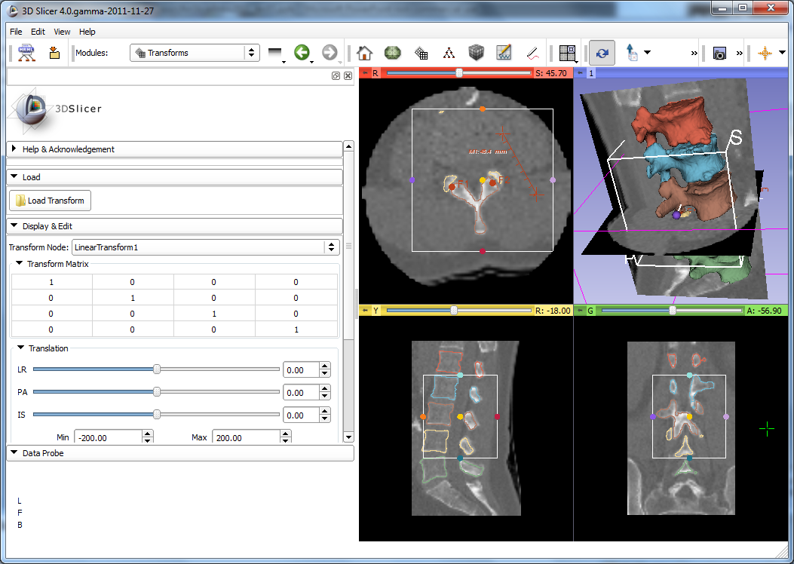
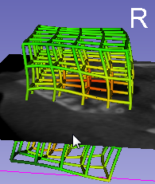
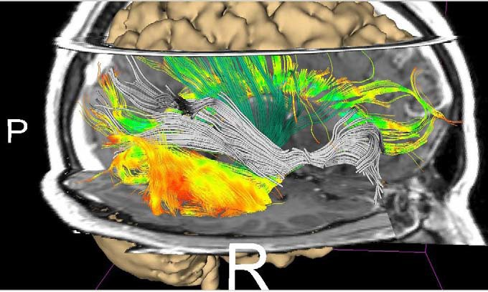
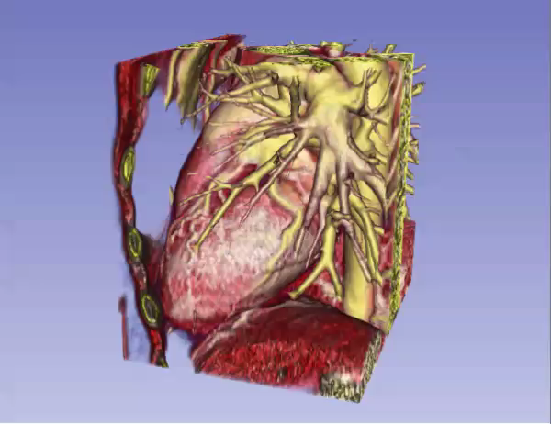
Visualization
2D (slice) and 3D views, chart views
Configurable layout
Multi-modality image fusion (foreground, background, label map)
Transforms, vector and tensor field visualization
Surface and volume rendering
Time sequence data
1
2, 3
4
5
6
Notes:
A multitude of options for visualization are available in Slicer (1,2,3,4,5,6).

Slide 17
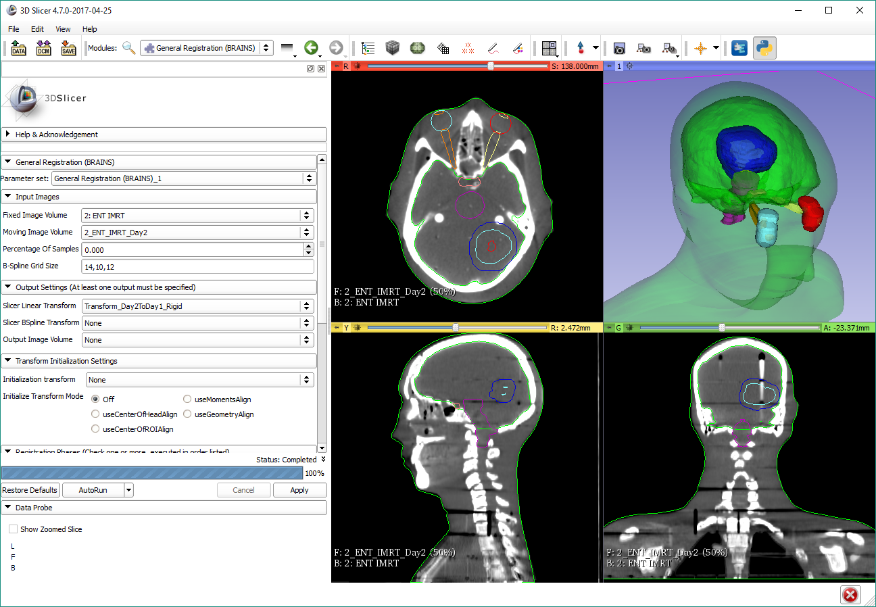
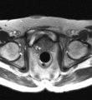
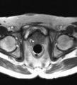
Registration
Manual: translation, rotation in 3D
Automatic: rigid, deformable, with various similarity metrics, initialization methods, optimizers, masking, etc.
Extensions: structure-based registration, Elastix, etc.
Notes:
As well as registration (which is the process of transforming different sets of data into one coordinate system, i.e. aligning images)
These are prostate MRI images, taken during MRI-guided robot-assisted prostate biopsy procedure; Slicer registers the high-resolution planning volume (acquired at the beginning of the procedure to plan biopsy targets) to the lower-resolution confirmation volume (acquired after the needle is inserted). The registration compensates for patient motion.

Slide 18
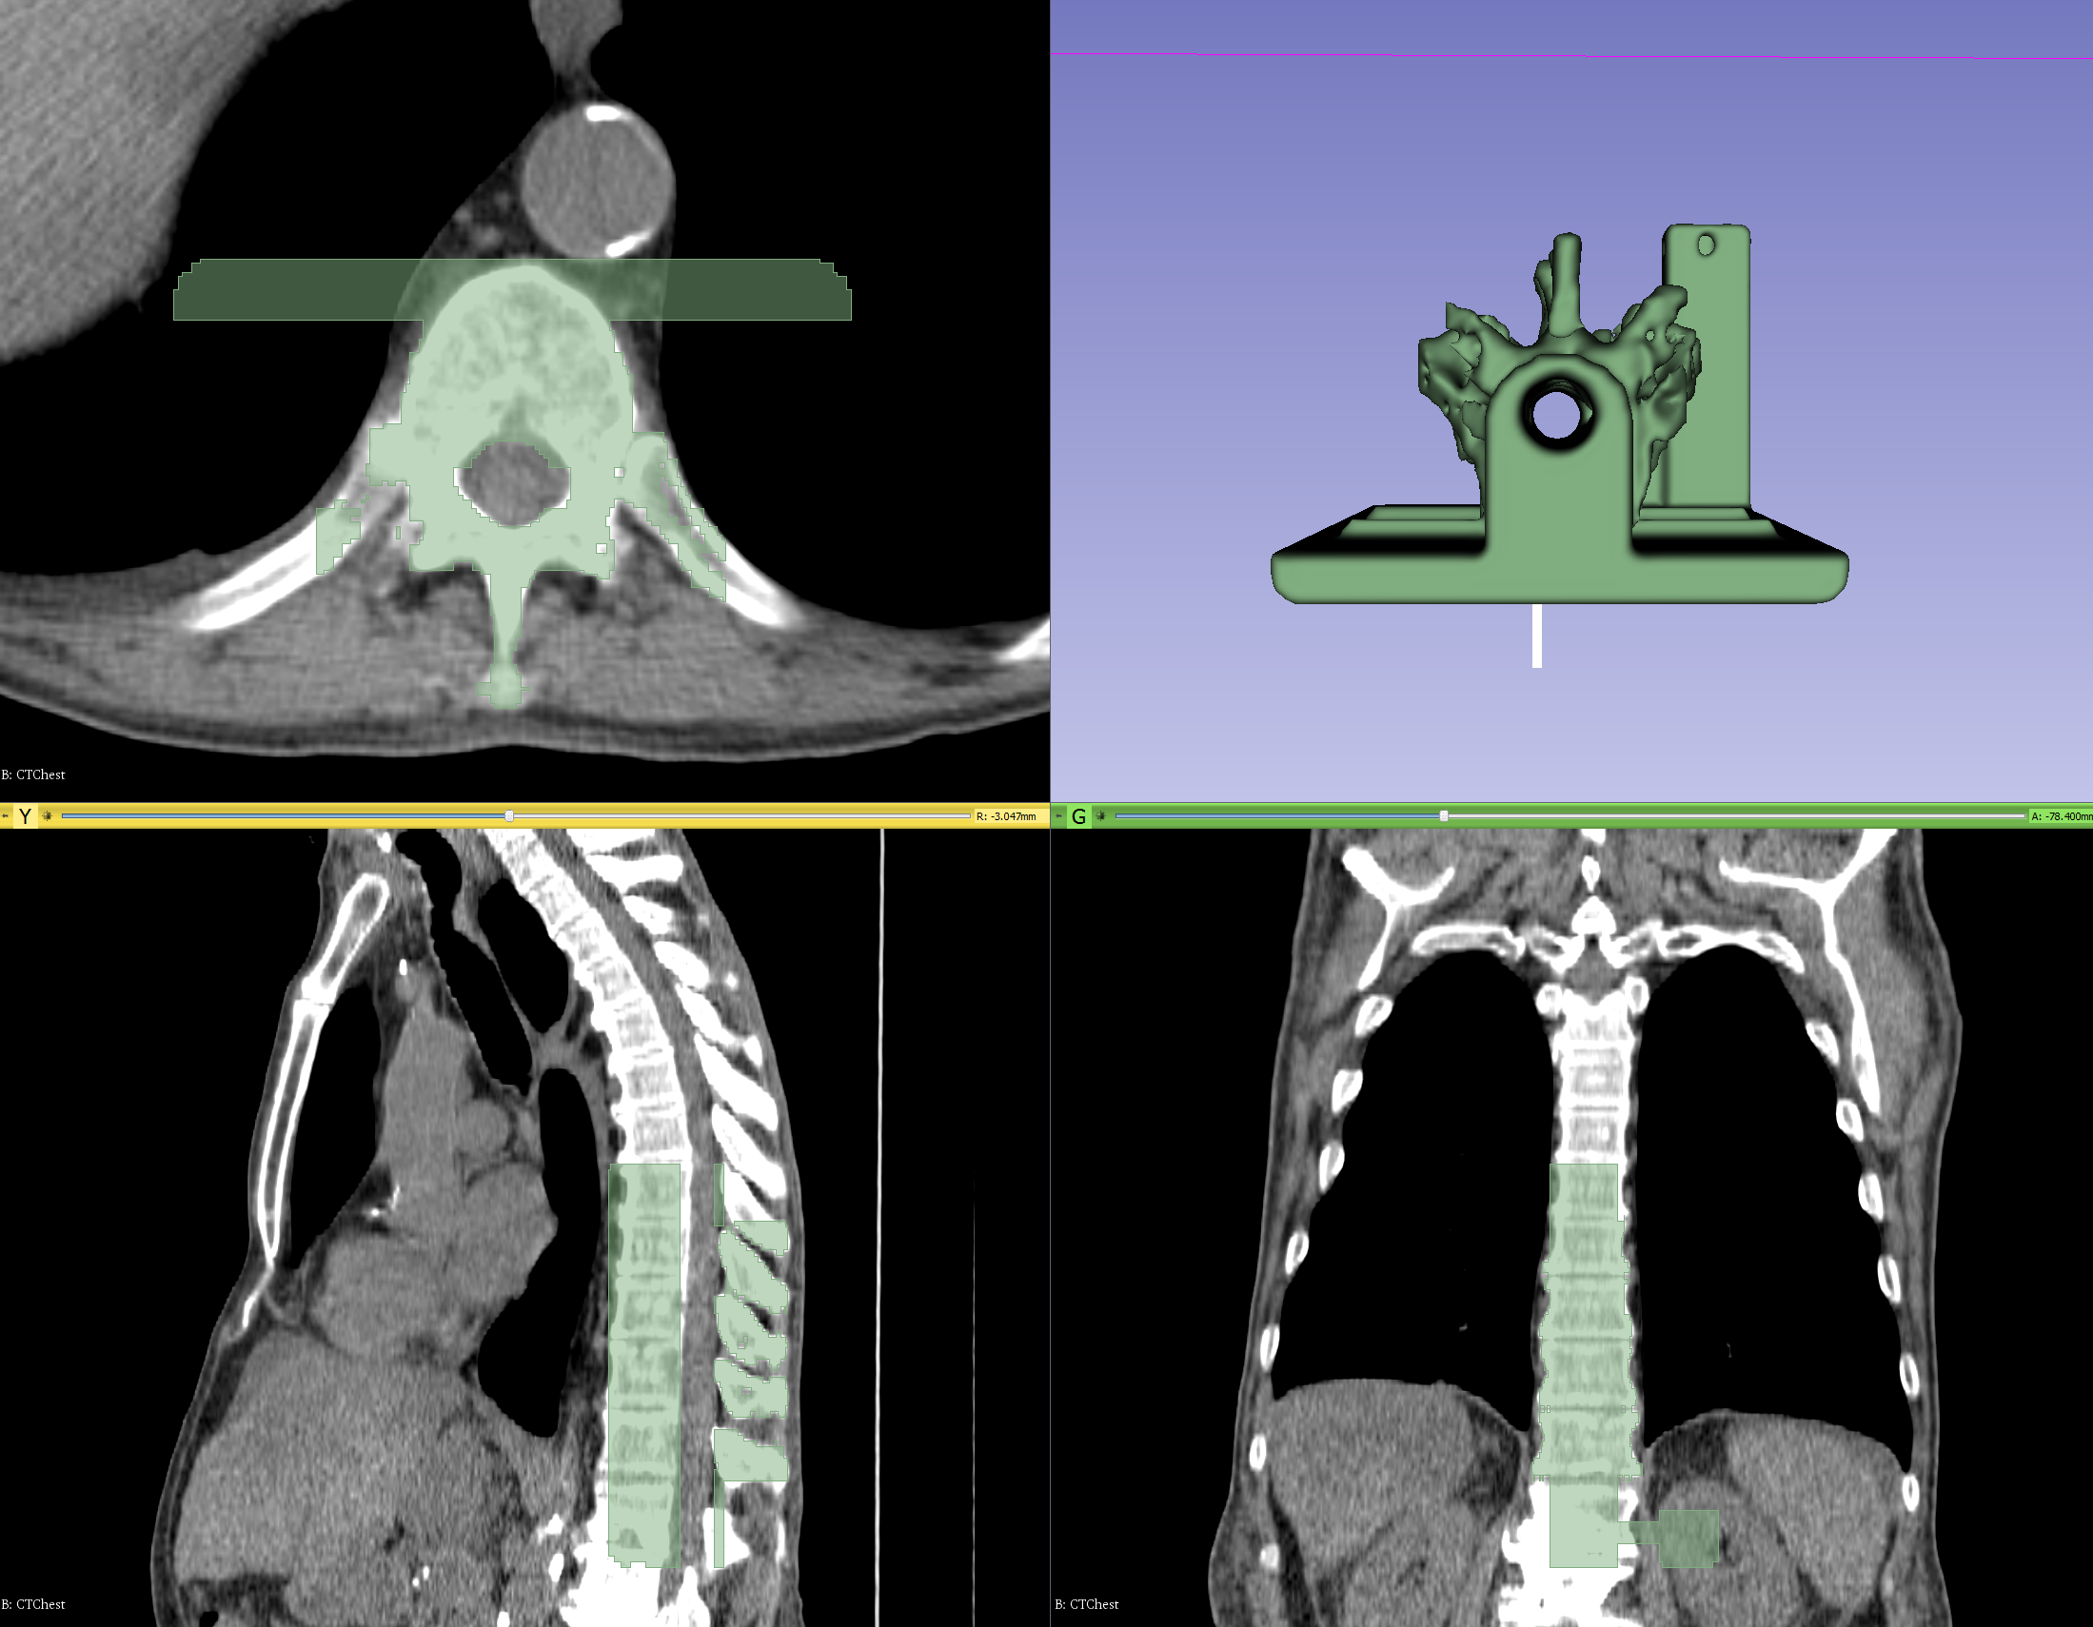
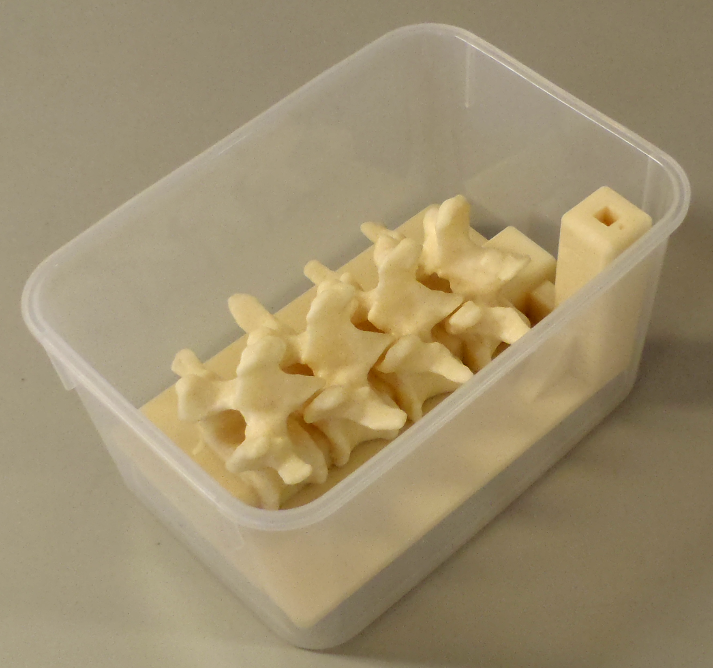
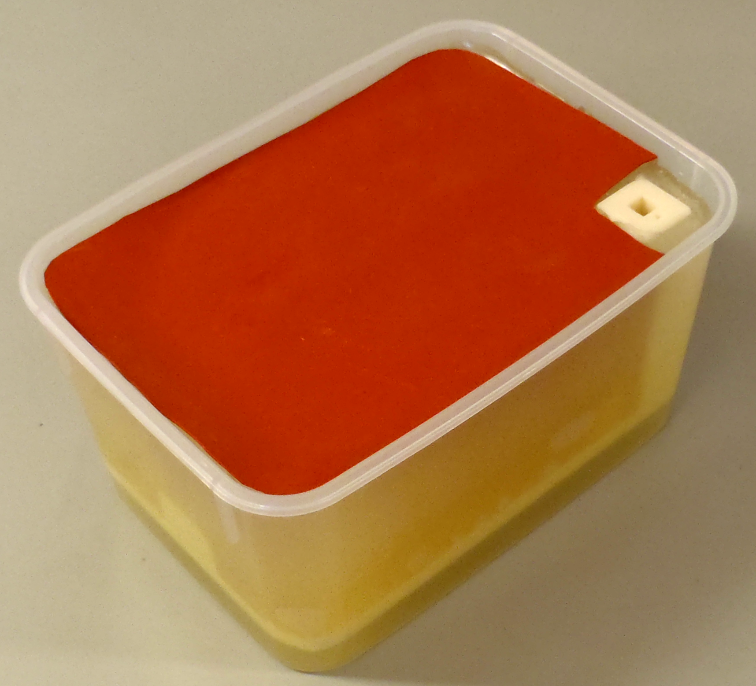
Segmentation
Manual (paint, draw, scissor, threshold, etc.)
Semi-automatic (region-growing, fill between slices, etc.)
Automatic (atlas-based, robust statistics, etc.)
Notes:
As for the common task of segmentation (which means to divide an image into multiple parts which is typically used to identify objects), Slicer supports both manual approaches (like contouring and painting) as well as automatic (like region-growing and atlas-based).
The Slicer screenshot here shows a segmented prostate in the Editor module where many of these tasks can be performed.

Slide 19
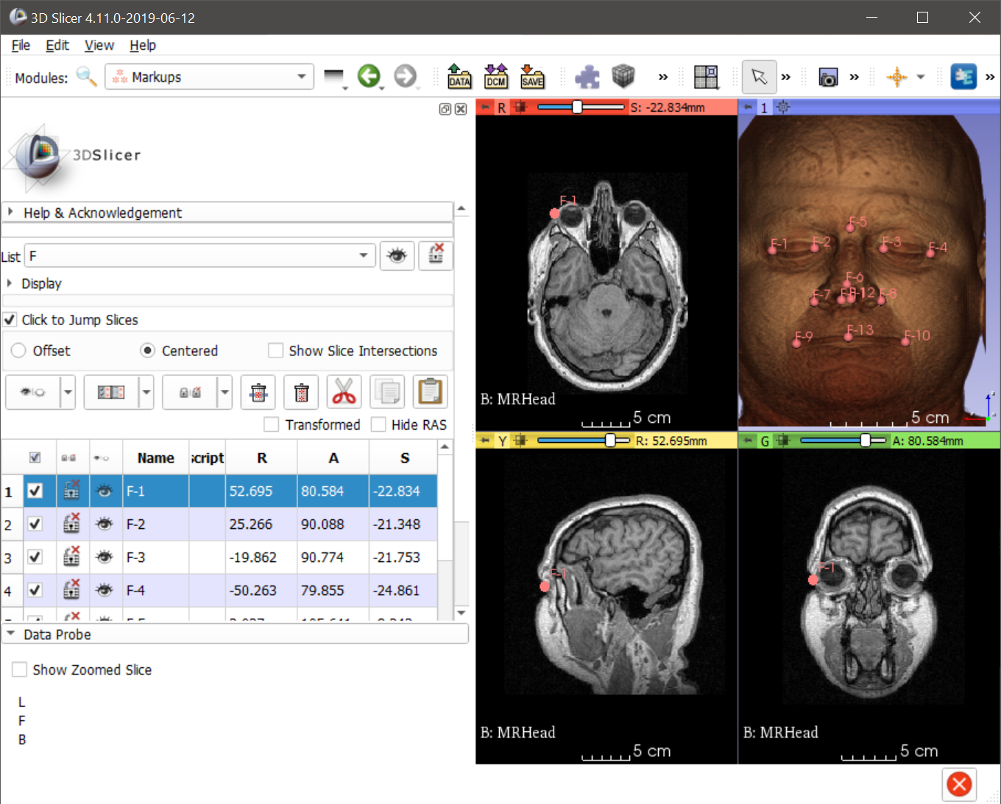
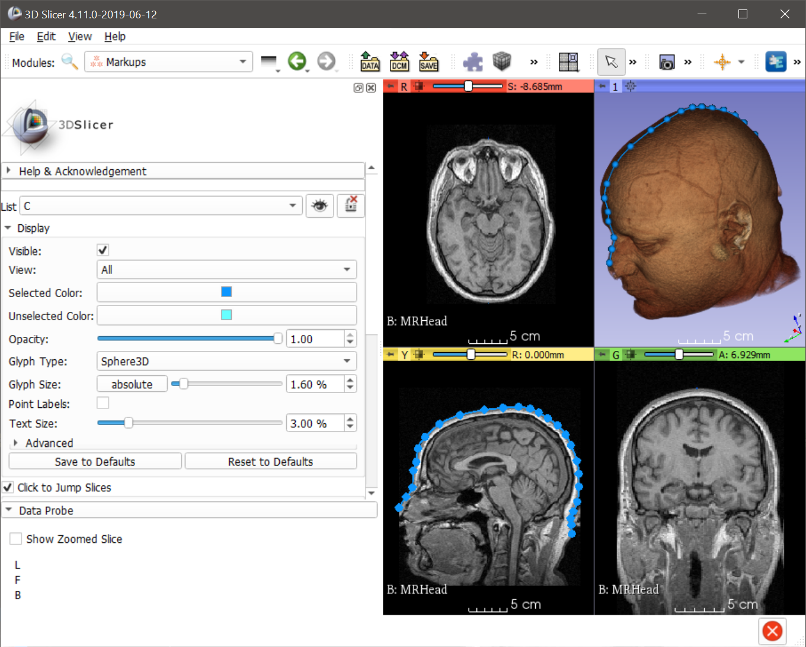
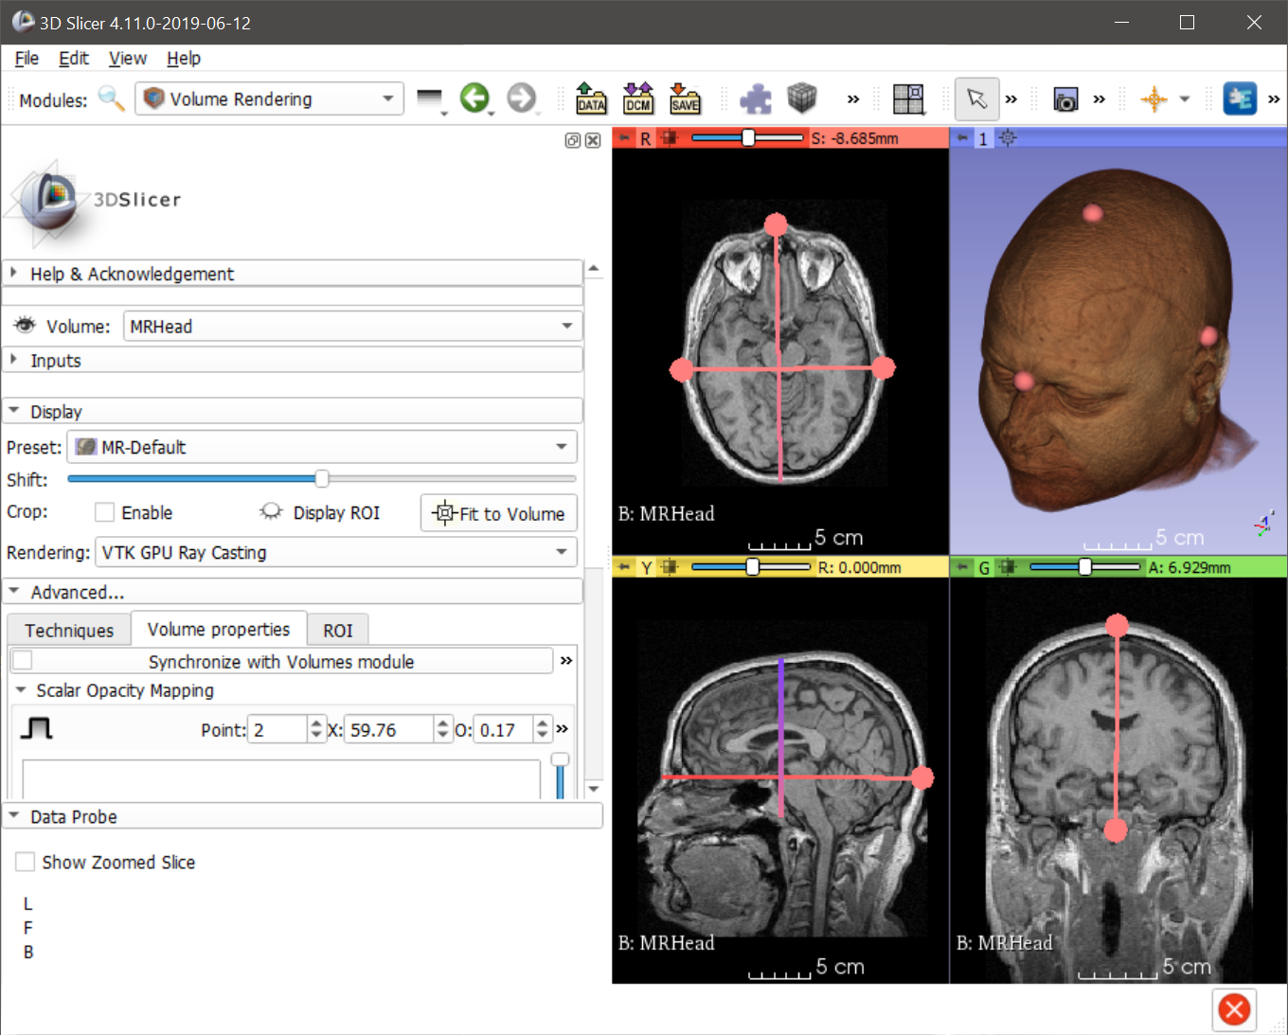
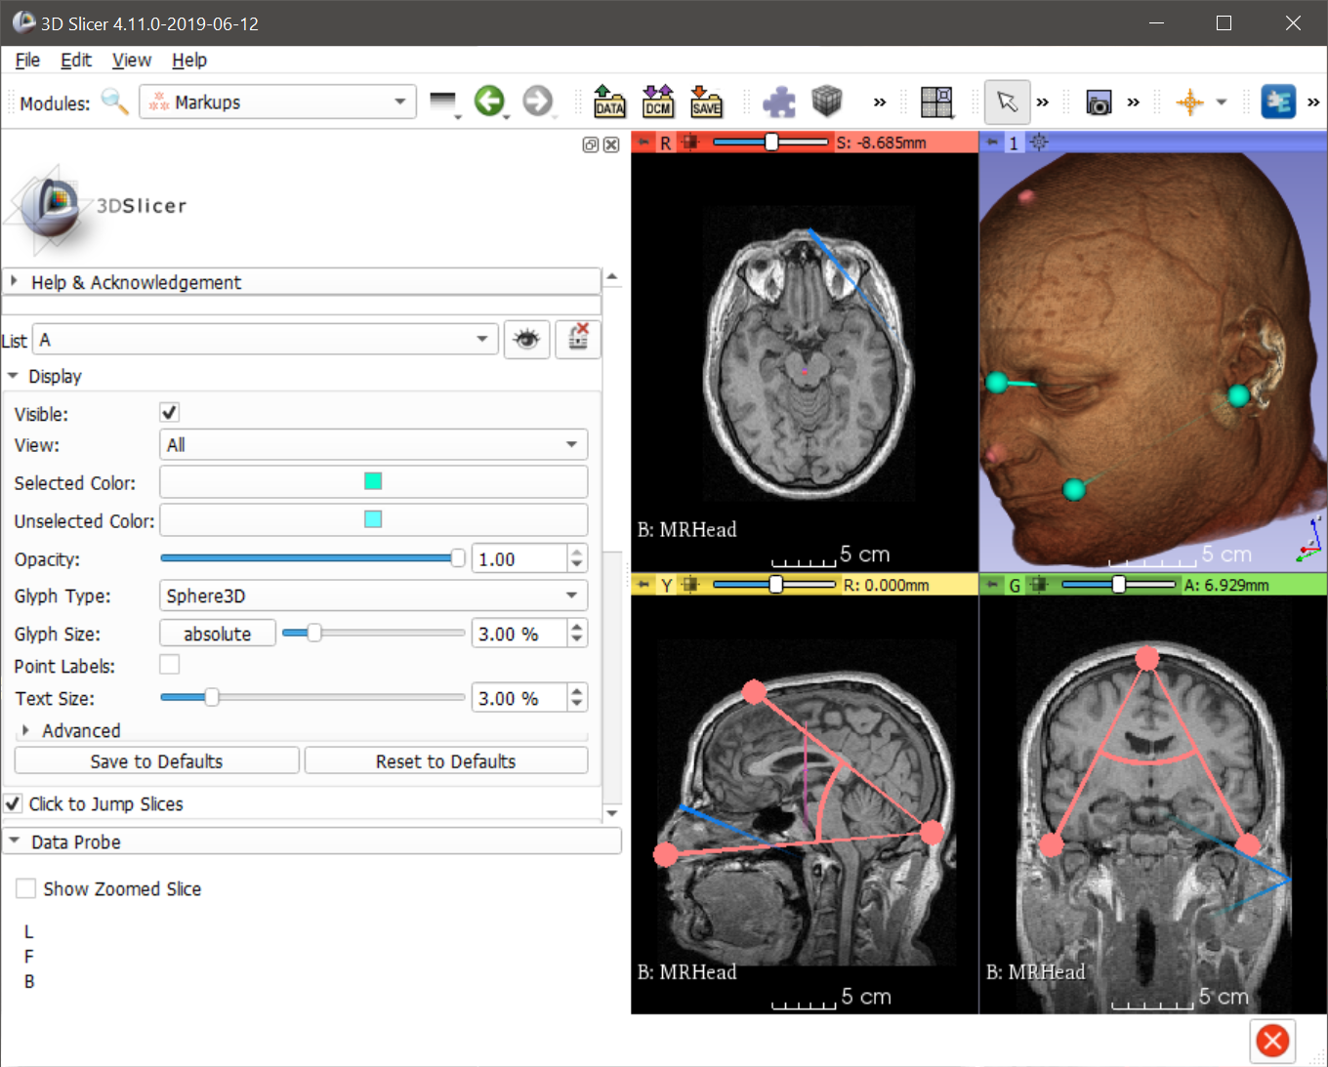
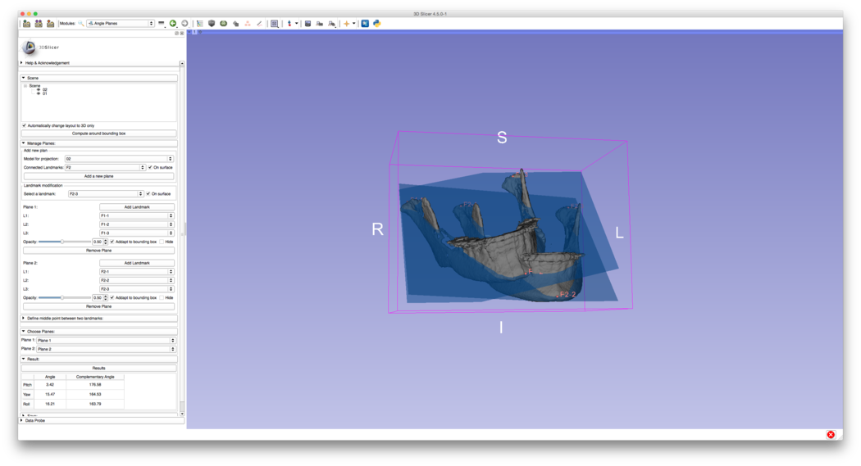
Annotations (Landmarks, Lines, Angles, Curves, Planes)

Slide 20
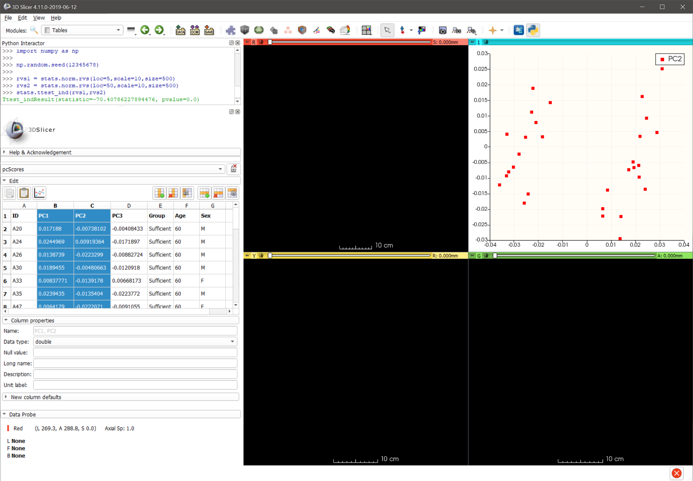
Data Tables, Plots, and statistics (w/ Python)

Slide 21
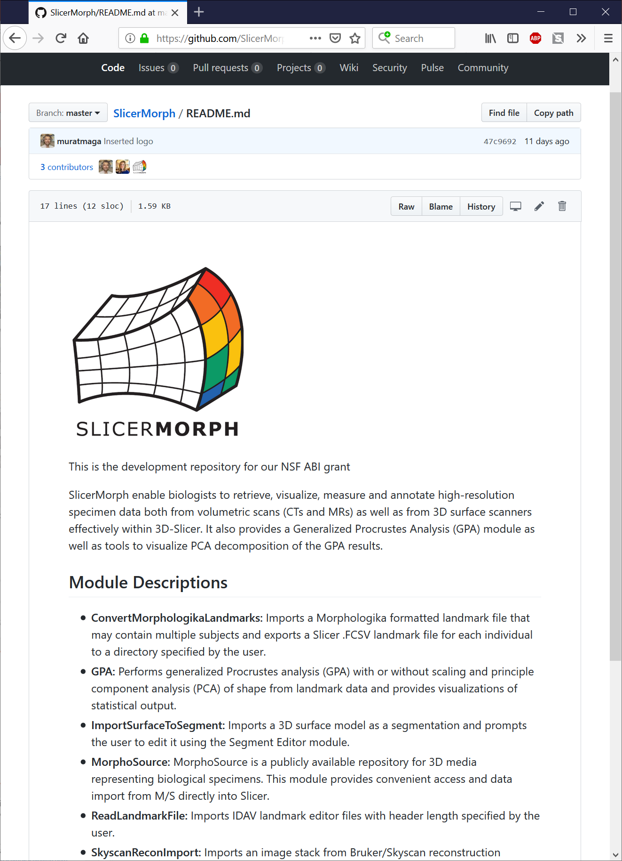
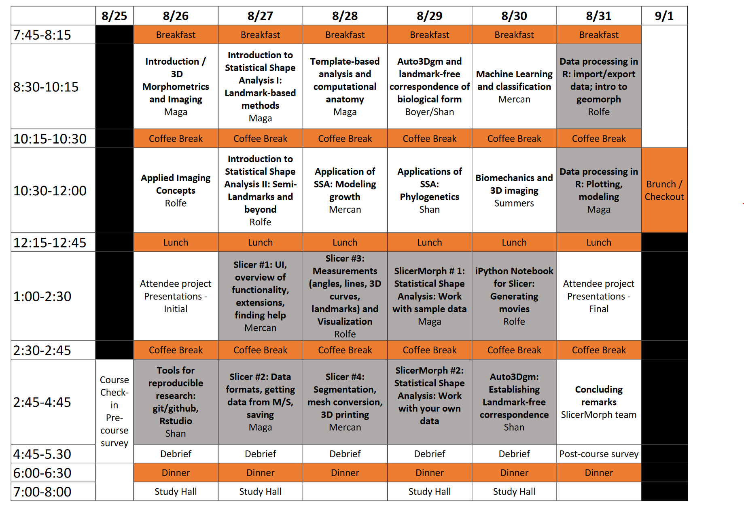
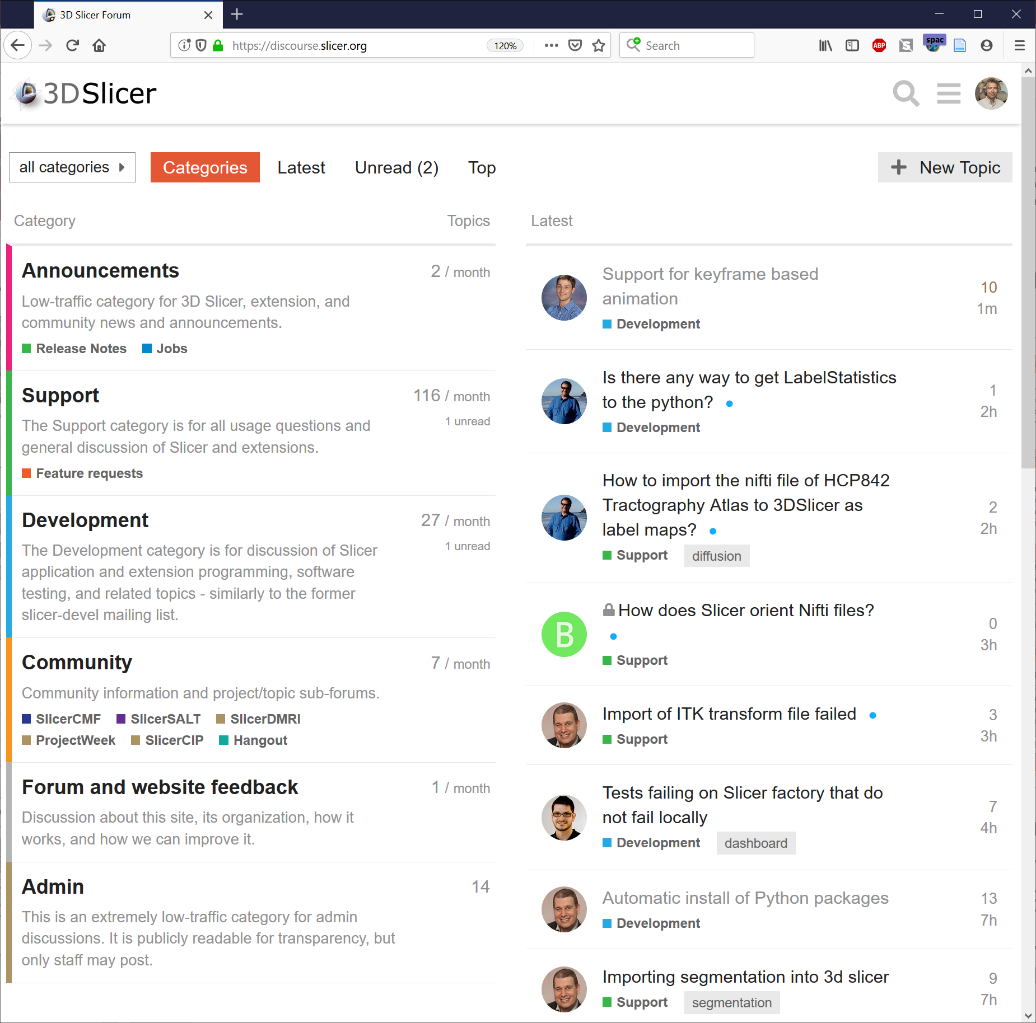
SlicerMorph: An Integrated Platform for Retrieval, Visualization and Analysis of 3D Morphology
3D Morphometrics And Image Analysis Summer Workshop
August 25-31, 2019
University of Washington, Friday Harbor Marine Laboratories, San Juan Island, WA
https://discourse.slicer.org
Four more workshops in 2020 and 2021
https://SlicerMorph.github.io

Slide 22
What’s inside Slicer?
Slicer core: Slicer GUI, I/O, visualization and developer interfaces
Slicer modules: internal plugins that depend on the slicer core
Slicer extensions: external plugins installed on demand by the user

Slide 23
Data handling: the MRML scene
MRML: Medical Reality Modeling Language
All objects (volumetric images, surface models, transforms, etc.) are stored in a hierarchical structure of MRML nodes
Each MRML node has its own list of custom attributes that can be used to specify additional characteristics for the data object
Enables the modules to have access to the MRML tree, allowing new extensions to leverage existing processing and visualization functions without directly interfering with other modules

Slide 24
Python in Slicer
The Python console of Slicer4 gives access to
Scene objects (MRML)
Data arrays (volumes, models)
GUI elements (Qt) that can be encapsulated in a module
Processing Libraries (more can be installed)
numpy
VTK
ITK
CTK

Slide 25
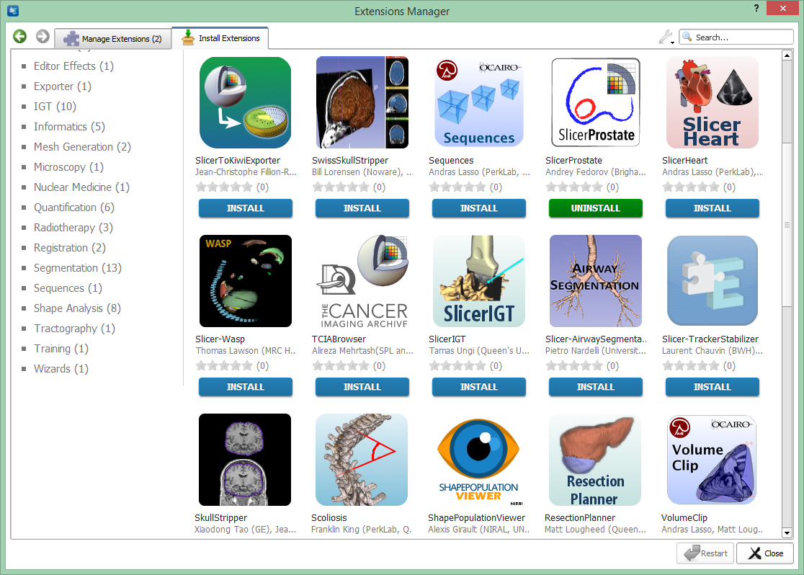
Slicer is extensible
The Slicer Extension Manager offers the possibility to the user to download and install additional Slicer modules

Slide 26


Without an application platform
Building on an application platform
Each application is developed from ground up
Completely new software is developed for each problem/procedure/device
Significant work is needed to integrate new, advanced algorithms
Core functionalities are already implemented
New software modules can be developed for specific needs
Many new, advanced algorithms are available
Well-supported with a large user and developer community
Quick start.
Huge waste of time, money, and effort overall.
Investment at the beginning: learning.
Minimal wasted efforts.
Notes:
Because, without an application platform
Show animations
On the other hand, if you are building your work on a pre-existing application platform
1. Portable (Win, Linux, Mac), Open-source

Slide 27
Survey of 3D morphometrics
Conducted on morphometrics online discussion group.
Challenges identified are:
Data wrangling (converting formats)
Annotation (landmarking, measurements)
Analysis and visualization
An Integrated Platform for Retrieval, Visualization and Analysis of 3D Morphology. 08/01/2018 – 07/31/2021
Murat Maga (Seattle Children's): NSF Award #1759883
Adam Summer (University of Washington): NSF Award #1759637
Doug Boyer (Duke University): NSF Award #1759839

Slide 28
How big of a dataset I can work on with Slicer?
Depends on what you want to do:
Rule of thumb 6-10X more RAM than your dataset size.
E.g. 1024x1024x1024 scan with intensity ranges from 0-4096 would be 2GB
Suggested RAM is be 12-20GB.
Most filters and tasks Slicer is multi-threaded, thus would benefit from multi-core computer architecture
If you do registration, requirements would approximately double
3D Volume Rendering (Raycasting) needs a high-end GPU with more memory than your largest dataset.
So, example above would work on a GPU with 3GB GPU RAM.
It also depends on your GPUs hardware capabilities (check gpuinfo.org)
CPU rendering always works, but slow (unless you have dozens of cores).
You can use downsample or crop your volume to match it to your hardware.
Keep your data as a 3D volume. Reading one large files is very fast compared to reading thousands of small files.
NVME SSDs are very good investment.

Slide 29




Acknowledgements
SlicerMorph Team
Sara Rolfe (UW/SCRI, Lead Developer)
Doug Boyer (Duke, SlicerMorph Co-PI)
Julie Winchester (Duke, MorphoSource)
Adam Summers (UW, SlicerMorph Co-PI)
Steve Pieper (Chief Software Architect of 3D-Slicer)
Slicer Developer Community
SlicerMorph Advisory Board
James Rohlf (Stony Brook University)
Dean Adams (University of Iowa)
David Polly (Indiana University)
Anjali Goswami (Natural History Museum, London)
Funding
NSF-Advances in Biological Informatics
Murat Maga (Seattle Children's): Award #1759883
Adam Summer (University of Washington): Award #1759637
Doug Boyer (Duke University): Award #1759839

Slide 30
3D Slicer: Open-source, extensible Volumetric imaging platform
Supports, variety of volumetric datasets (DICOMs, and other image stacks, Nifti/Analyze, and many other 3D formats)
Supports surface (polygon) models (stl/ply/vtk).
Have extensive image processing (filters), image segmentation and registration libraries (both affine and deformable).
Very stable core 3D visualization (volume rendering, animation, time-series) functions
Ability to make quantitative analysis and plots
Extensible through plugins (currently more than 100 different plugins provide functionality in addition to the core features listed above).
http://slicer.org and https://www.slicer.org/wiki/Documentation/4.6/Extensions

Slide 31
Benefits of approach:
One platform for retrieval, visualization, annotation (segmentation or measurement) and analysis of specimen data (all within Slicer).
Open standards will facilitate easier exchange and collaboration between labs.
My lab developed the proof-of-concept in 2014, and has been using in the lab.
Maximize return on investment by facilitating easier access to NSF supported biorepositories.

Slide 32
Major goals of the proposed project
AIM 1. Develop a geometric morphometric (Procrustes) analysis toolkit for Slicer and distribute via the extension manager. This will support both 3D data, as well as 2D (e.g. pictures of fly wings, leaves etc) which is the bulk of the data stored in biorepositories.
AIM 2. Develop an aggregate data mart (MorphMart) within Slicer so that users have one user interface to obtain data from public repositories (collaboration MorphoSource, DigiMorph, etc).
AIM 3. Dissemination: Organize workshops for best practices in image processing and visualization of volumetric 3D data, geometric morphometrics, and analysis through the developed toolkit.

Slide 33
Benefit of open-source development
While there are currently open source tools to analyze landmark data (as extensions of R statistical analysis package), there is none for generalized data collection.
Available free academic software are: TPS suite (Jim Rolhf at Stony Brook), Morpheus et al. (Dennis Slice, FSU), IDAV Landmark editor (UC Davis, no longer available via website). None of them are open source. One R package, StereoMorph, allows users to collect 3D landmarks and curves from objects using digital cameras
In the event of loss of funding, or the developer losing interest (or the ability) in maintaining the software, there is nothing for community to keep the software up-to-date (or even available as-is, as seen by IDAV Landmark Editor). In open-source model, even if the core development group loose funding, disband or change focus, the community have access the full source code and any one else can pick up the development or maintain as it is in perpetuity.
It is particularly appealing for publicly funded projects. Extensive being used in biomedical imaging.

Slide 34
Common Data format: Nearly Raw Raster Data (NRRD)
NRRD provides abstractions to define: resolution, coordinate system, space origins and directions for the image data (whether it is 2D, 3D or 4D). http://teem.sourceforge.net/nrrd/
Additional project specific data fields can be added. An example of NRRD data description is on the right (project specific meta data prefixed by #)
Our goal is to provide raw volumetric data in a consistent manner, so that mirroring (incorrect coordinate system description) or deformation of specimen (incorrect specified aspect ratios, or voxel dimensions) is not encountered and correct quantitative information can be extracted and retained.
While 3D surface models (stl/ply/vrmls etc) provide a convenient modality for the end user, certain assumptions go into converting a volumetric image data to a surface model (e.g. a threshold that will give a smooth cranial surface is not necessarily the same threshold that will enable a user to extract intricate turbitane bones, or middle ear ossicles of a skull). This is should be determined by the specific question and is best left to the individual investigator. Hence, the image data should be retained.
Our workshops will cover topics related to these issues.
NRRD0004
content: Skull CT
# Specimen No: 627546
# Institution: USNM
# Genus: Homo
# Species: sapiens
# Specimen DOI/URL: where data is stored/downloaded
dimension: 3
type: short
Space: RAS
Space Directions: (0.5, 0, 0) (0, 0.5, 0) (0, 0, 1)
sizes: 512 512 256
data file: ./USNM627546_Skull_CT.raw.gz
encoding: gzip
##########
This NRRD header data explicitly specifies that this is a 3D scan with X Y and Z dimensions of 512, 512, 256 voxel. Has reference coordinate system as (Right Anterior Superior, i.e. where the origin of the dataset is). The type of the voxels are short integer (16 Bit integer), voxel spacing is 0.5mm in XY dimensions and 1.0mm in Z dimensions. Actual image data is specified explicitly and NRRD supports a variety of compression and encoding schemes (DICOMS, PNG/TIFF sequences, and other data formats).

Slide 35
Project organization
Maga lab (at Seattle Childrens): Core development of morphometrics and data retrieval, landmark push toolkit. Also will support hubs for batch data conversion (to provide unified data structure and file format among sites). Main project hub (PI and full-time salary for professional programmer or equivalent)
Off-sites (MorphoSource, DigiMorph, etc…): Implement the APIs and instrumentation necessary on their backend to support data retrieval within the Slicer module (each site is likely to factor in some personnel effort to redesigning the data backend).
Steve Pieper (MIT Visualization Lab and Isomics Co). One of the lead developers of 3D Slicers. Dr. Pieper will serve as the consultant and liaison between our project and main Slicer development.
Advisory/steering committee: David Polly, Dean Adams, Anjali Goswami, Jim Rohlf: These individuals are leaders of GMM field, and will serve as an advisory group and stakeholders to make sure the community needs are fulfilled.

Slide 36
Maga Lab is hiring! Two-open post-doc positions
Postdoc in Genetics of Craniofacial Shape and Form
This NIH funded project is aimed at using computational anatomy and 3D morphometrics to understand the genetic structure of craniofacial shape and form using inbred strains of mice .
Qualified candidates are expected to have a strong background in craniofacial biology and development, or in quantitative genetics and bioinformatics. Preference will be given to candidates with experience conducting genome-wide efficient mixed-model association studies.
Proficiency with R or python is mandatory. This is a one-year position, with an option to renew for one more year based on performance and available funding.
Expected start date is October 1st 2019 (or sooner).
Postdoc in Machine Learning in 3D Image Analysis.
This NSF funded position is a collaborative project between five institutions (University of South Dakota, Seattle Childrenâ€™s, Virginia Tech, Drexel, and Tulane) to develop next-generation biology-guided convolution neural nets to enable machine discovery of organismal traits using existing 2D and 3D annotated imagery from aggregate specimen archives (such as MorphoSource, or iDigBio), as well as existing information from developmental and anatomical ontologies and phylogenies.
Post-docs in the program will have a chance to cross-train in different fields of phylogenetics, vertebrate morphology (ichthyology in particular), data-science and machine learning through rotations in participating sites.
For the project at Magalab, we are seeking trainees that either have PhDs in computer vision (or related) research and interested in applying their research in organismal biology context, or biologists with a strong computational background interested in learning image analysis. This is a two-year position, with an option to renew based on performance and pending project renewal. Expected start date is December 1st 2019 (or sooner).
http://faculty.washington.edu/maga/post-docs/
Or email maga@uw.edu

Slide 37
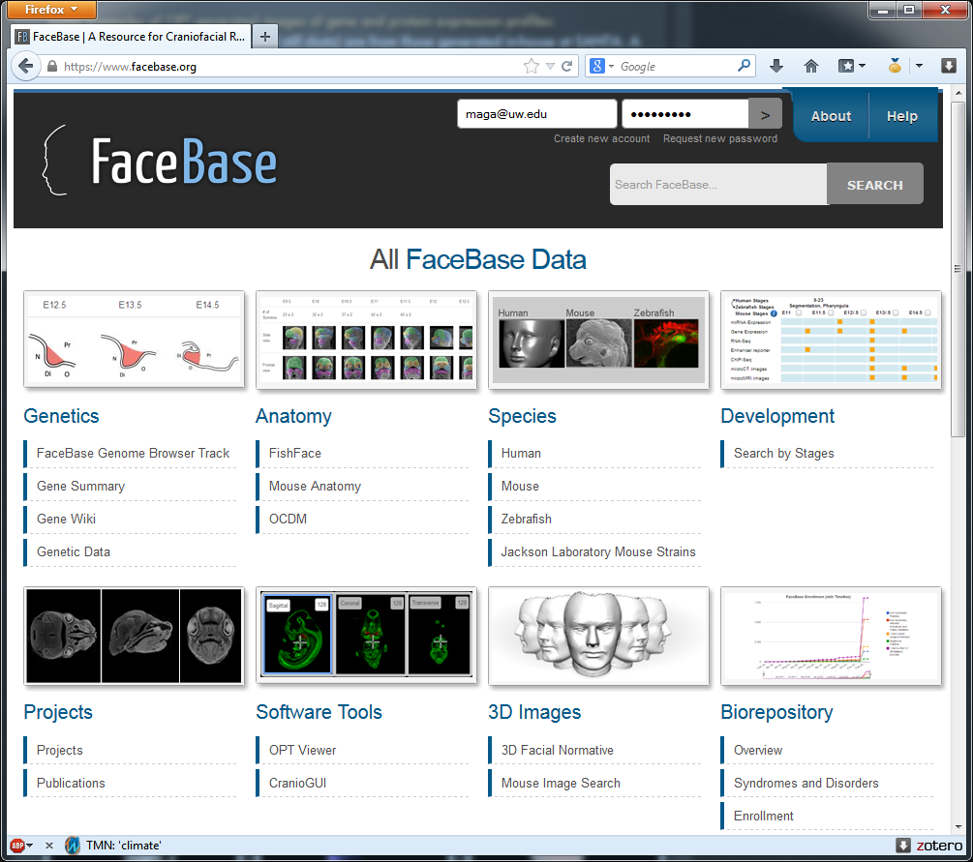
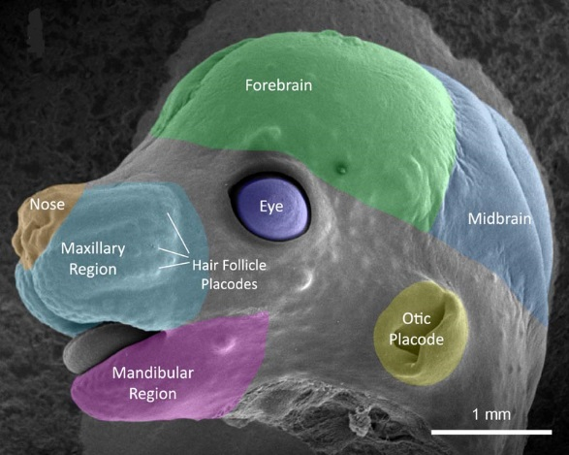
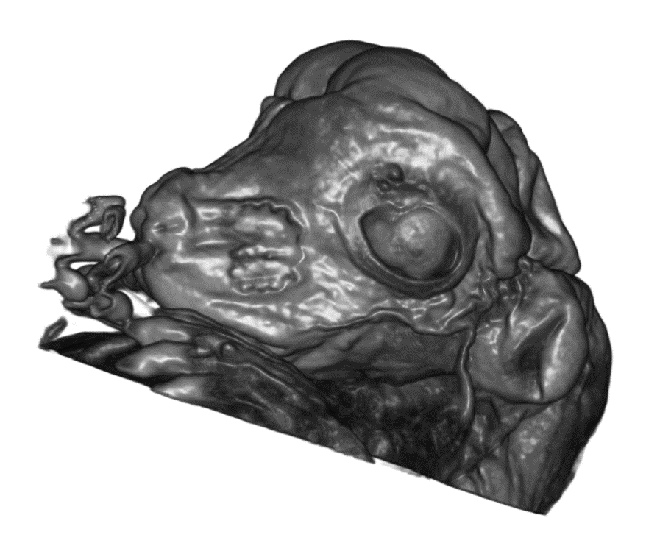
Don’t believe everything you see.

Slide 38
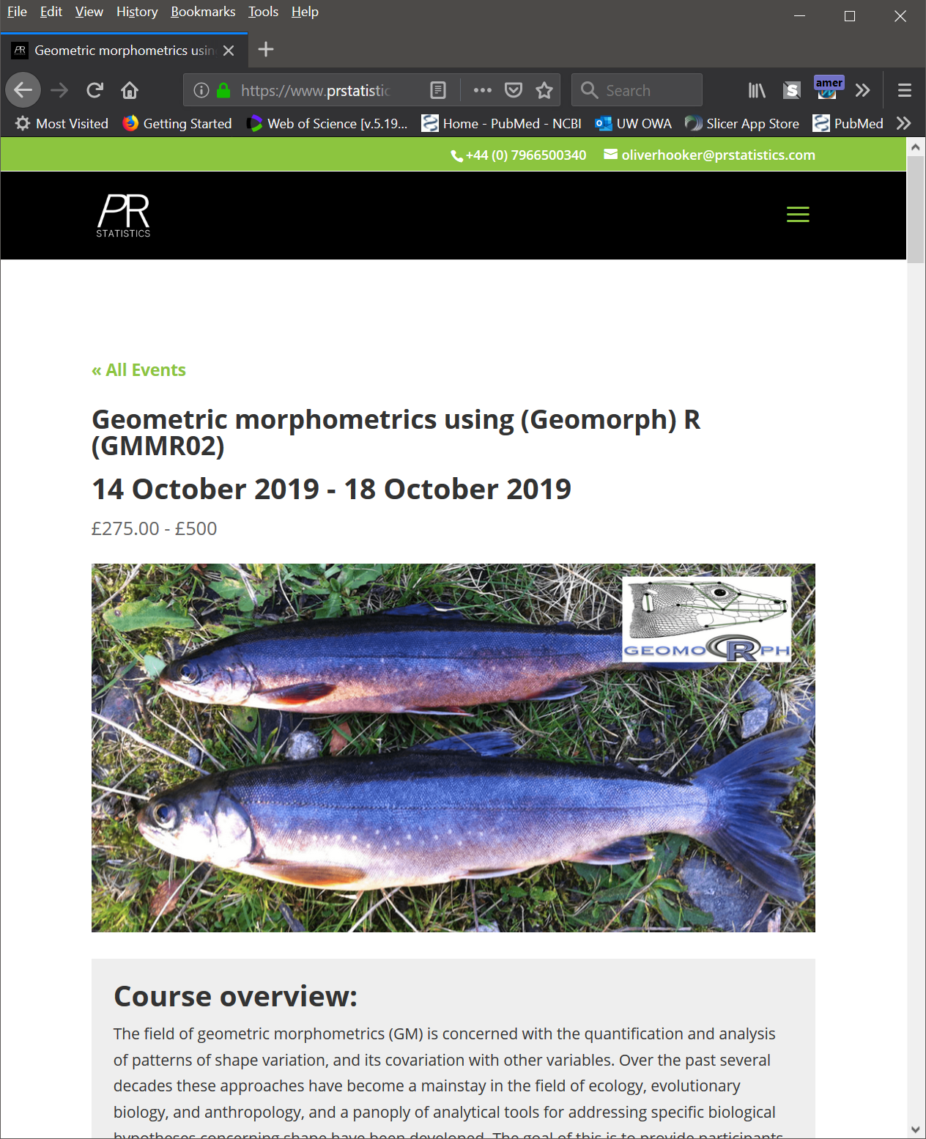
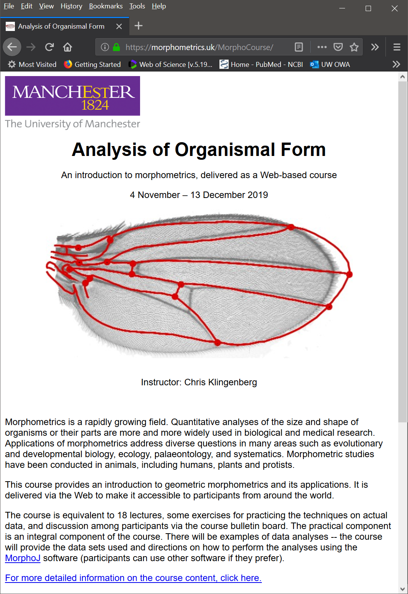
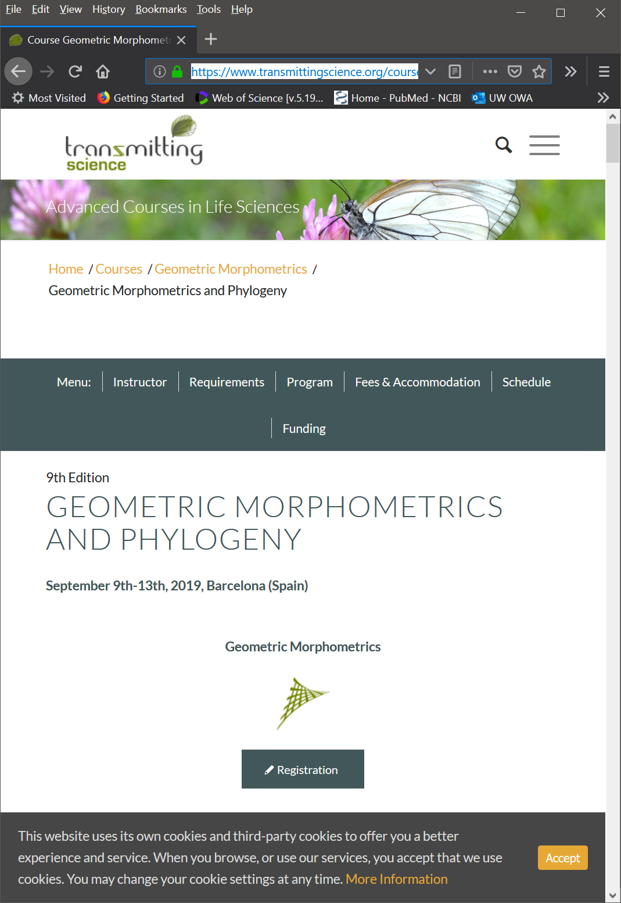
Geometric morphometrics specific short courses
https://www.prstatistics.com/course/geometric-morphometrics-using-r-gmmr02/ (Dean Adams)
https://morphometrics.uk/MorphoCourse/ (Chris Klingenberg)
https://www.transmittingscience.org/courses/geometric-morphometrics/geometric-morphometrics-phylogeny/

Slide 39
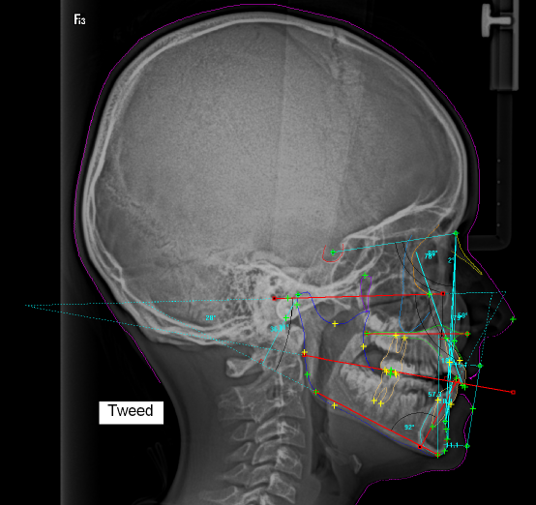
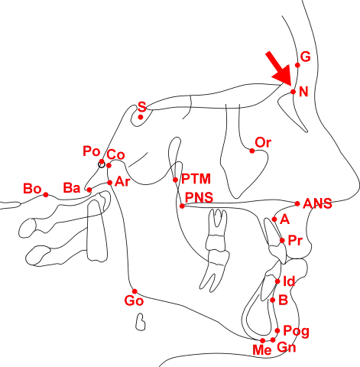
Data acquisition: 2D, Cephalometry

Slide 40
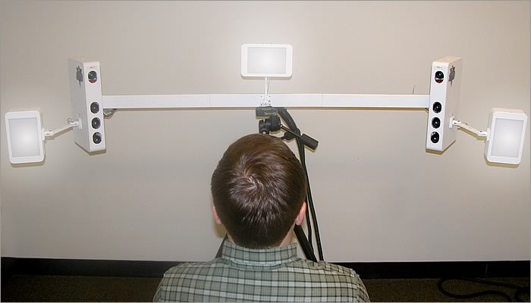
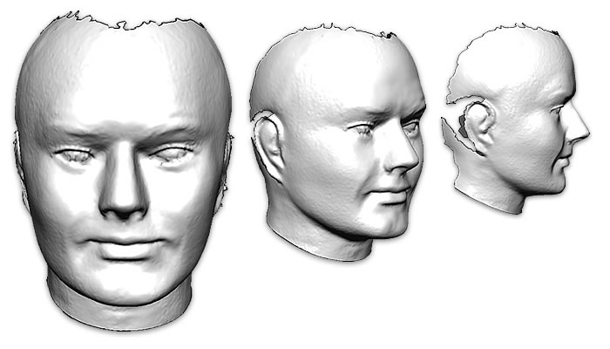
Data acquisition: 3D Photostereogrammetry

Slide 41
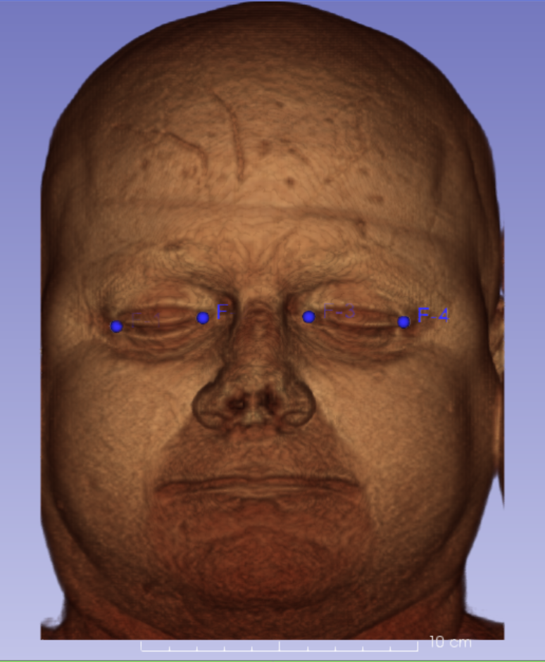
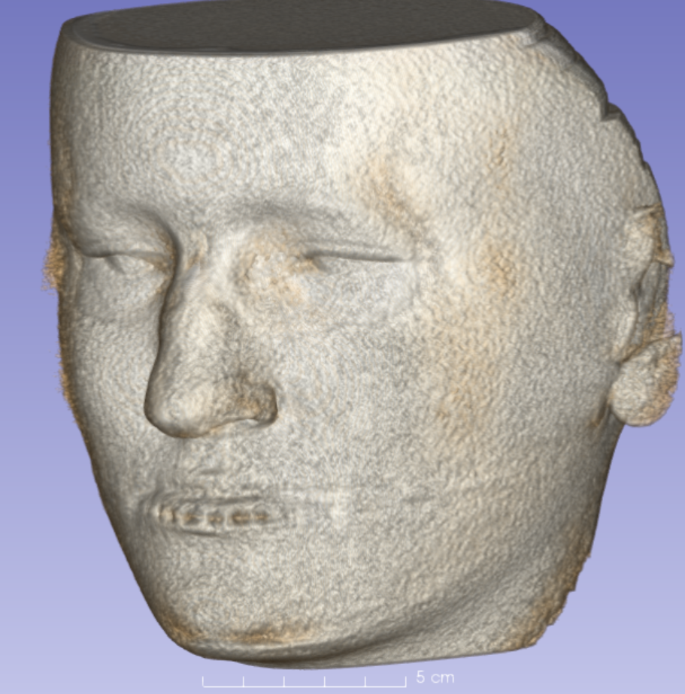
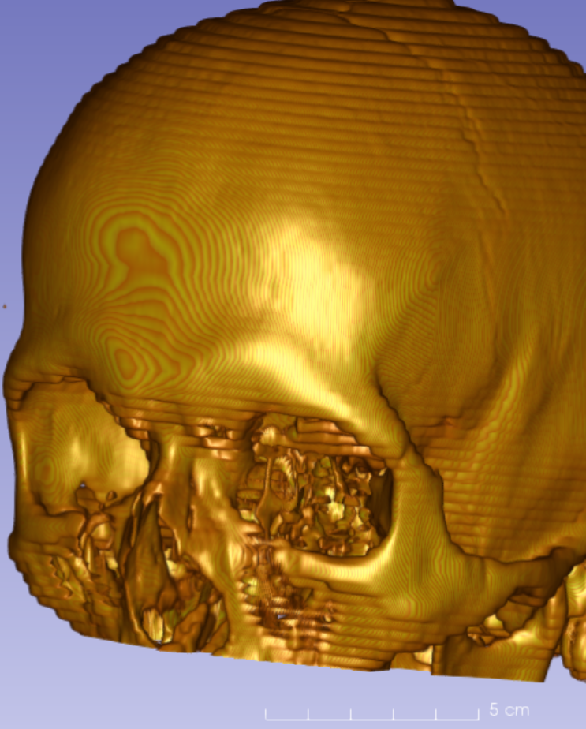
Data acquisition: Volumetric scans (MR, CT, CBCT)
MRI
CBCT
CT

Slide 42
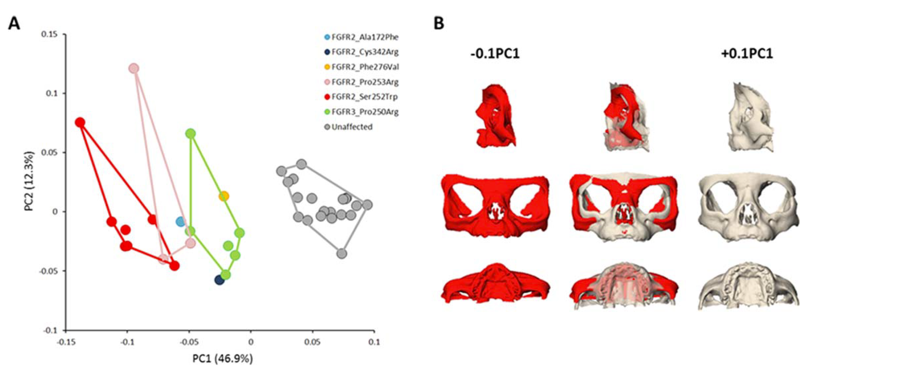
PCA is a great tool to shape summarize variation
Heuzé Y, et al. 2014. Quantification of facial skeletal shape variation in fibroblast growth factor receptor-related craniosynostosis syndromes. Birth Defects Research Part A: Clinical and Molecular Teratology 100:250–259.

Slide 43


Notes:
Figure 5. Fully segmented adult mouse skull from high-resolution microCT. While semi-automated segmentation algorithms can help the expert, segmentation of skulls and other fused structures remains a manual procedure with significant time commitment (e.g., full segmentation of this 35 micron adult skull takes about 40-50h, orders of magnitude more than 2D pictures).

Slide 44





Moving beyond state-of-art and why now?
BUT
Features that distinguish a car from a tree is not necessarily informative to detect difference in species.
Features need to have a biological basis (share a common developmental and evolutionary origin).
We don’t know this for EVERY trait, but we know for some.
Can we use this knowledge to discover new traits?
1900s
1990s-2010s
Now -
ML-based computer vision methods revolutionized image processing and classification in last couple years,

